Slide 1


AI in Chemistry
The New Catalyst for Discovery

Slide 2

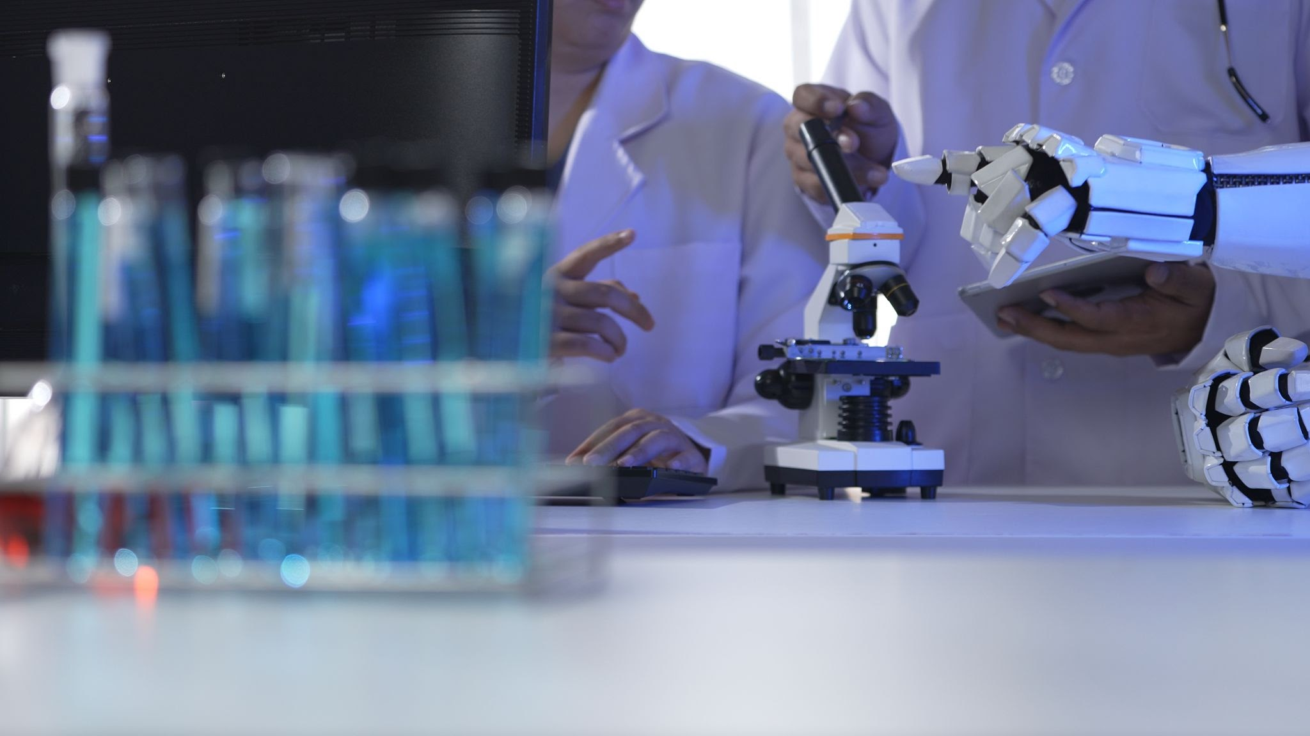
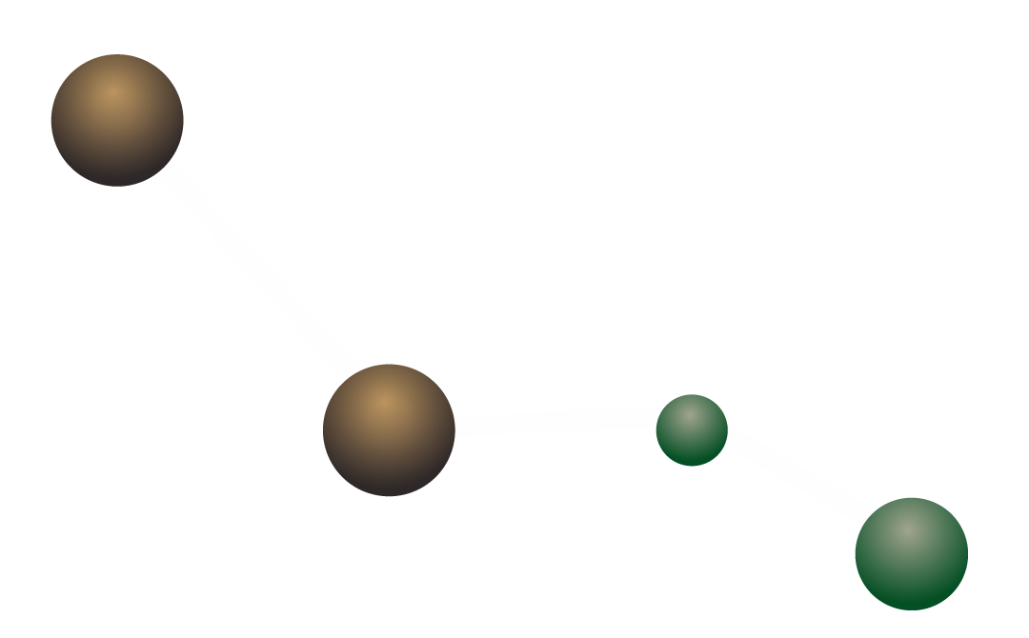

Slide 3
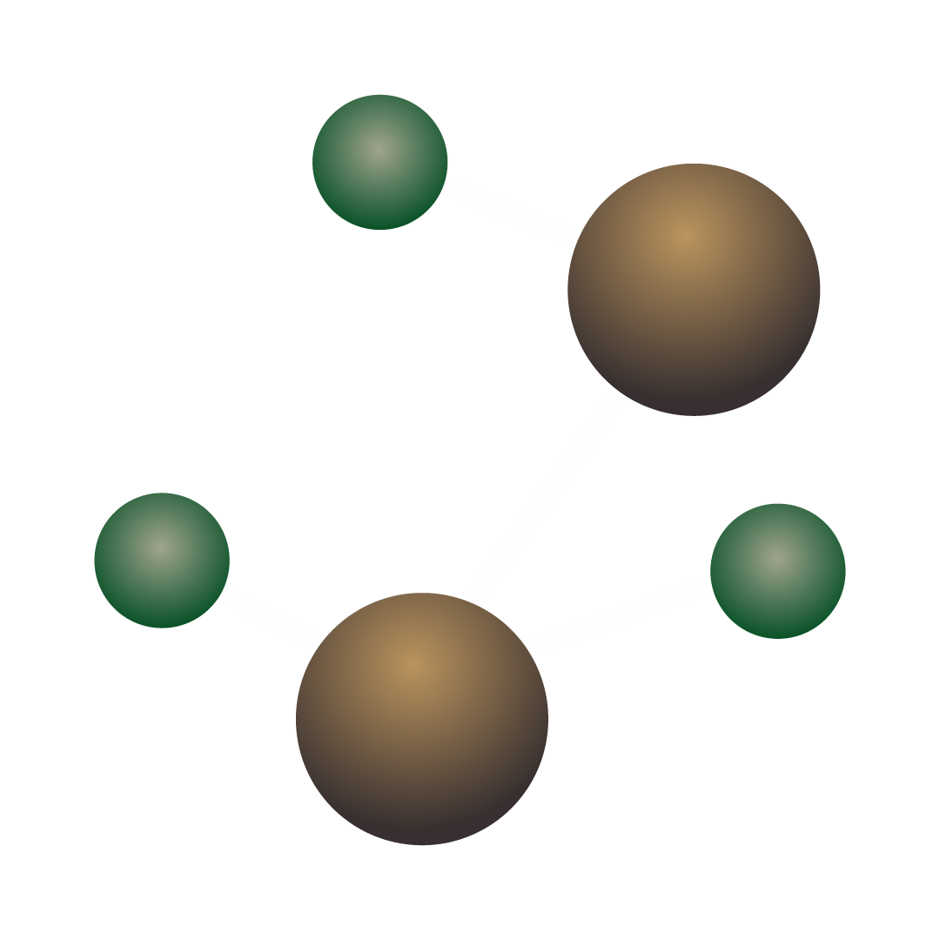
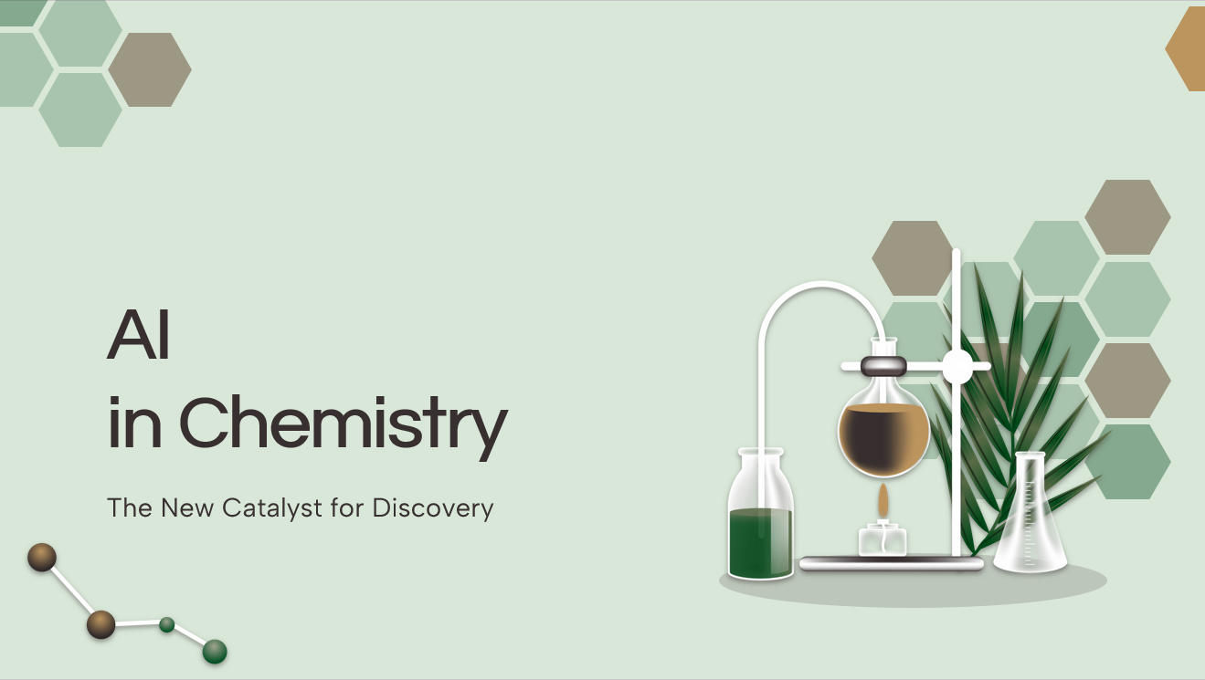
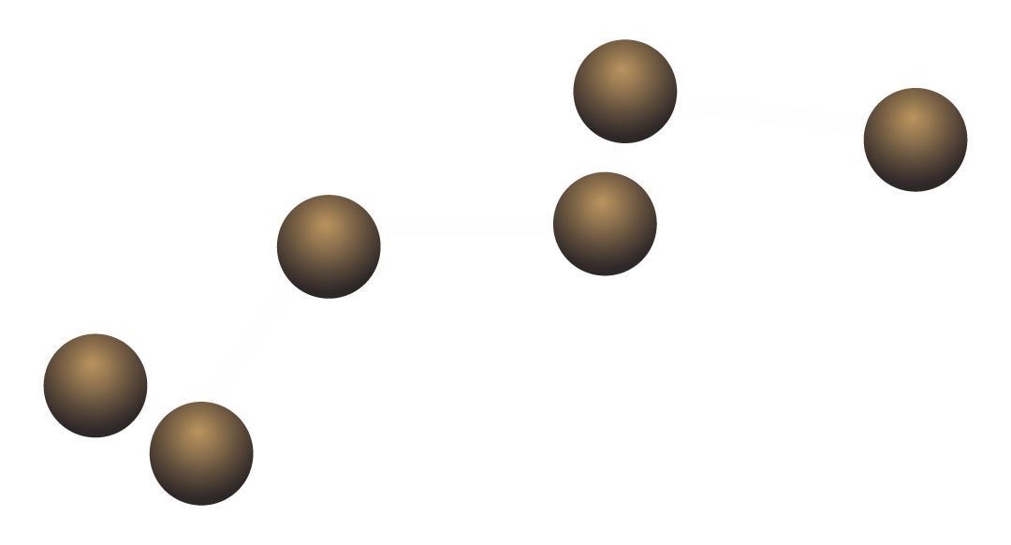
Team: The Atomic Thinkers

Slide 4




Our team
Thasinur Mohian
MD. Minhaz Uddin
C243123
C243106
Shajidul Hoq Galib
C243105

Slide 5
Table of contents
I
II
III
IV
V
VII
Introduction
Applications of AI in Chemistry
AI in Drug Discovery
VI
AI in Material
Science
Conclusion
AI in Structure Prediction
AI in Laboratory Automation

Slide 6
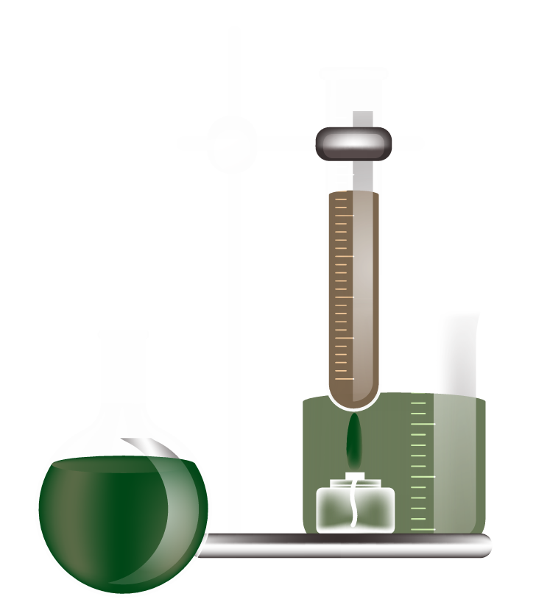

I
Introduction

Slide 7
What is AI?
1) AI = Artificial Intelligence.
2) A computer system that can think, learn and solve problems.
3) AI helps scientists do tasks faster, easier and more accurately

Slide 8
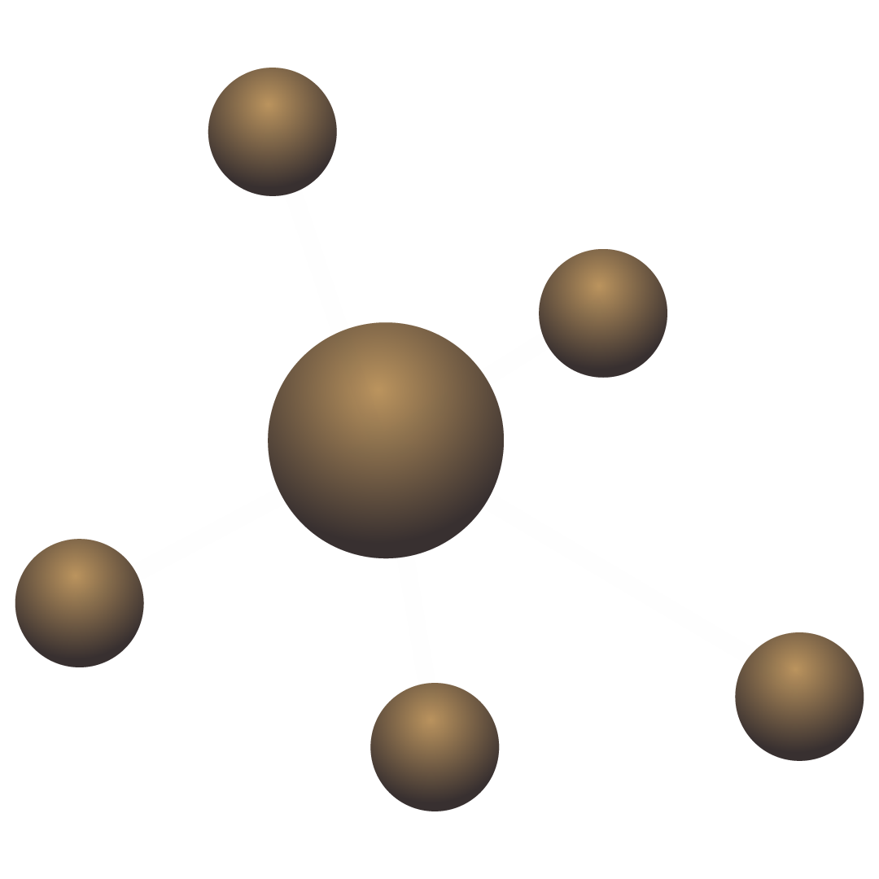
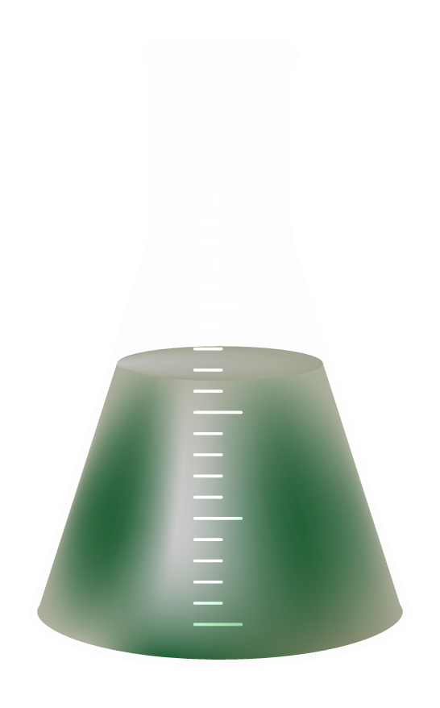
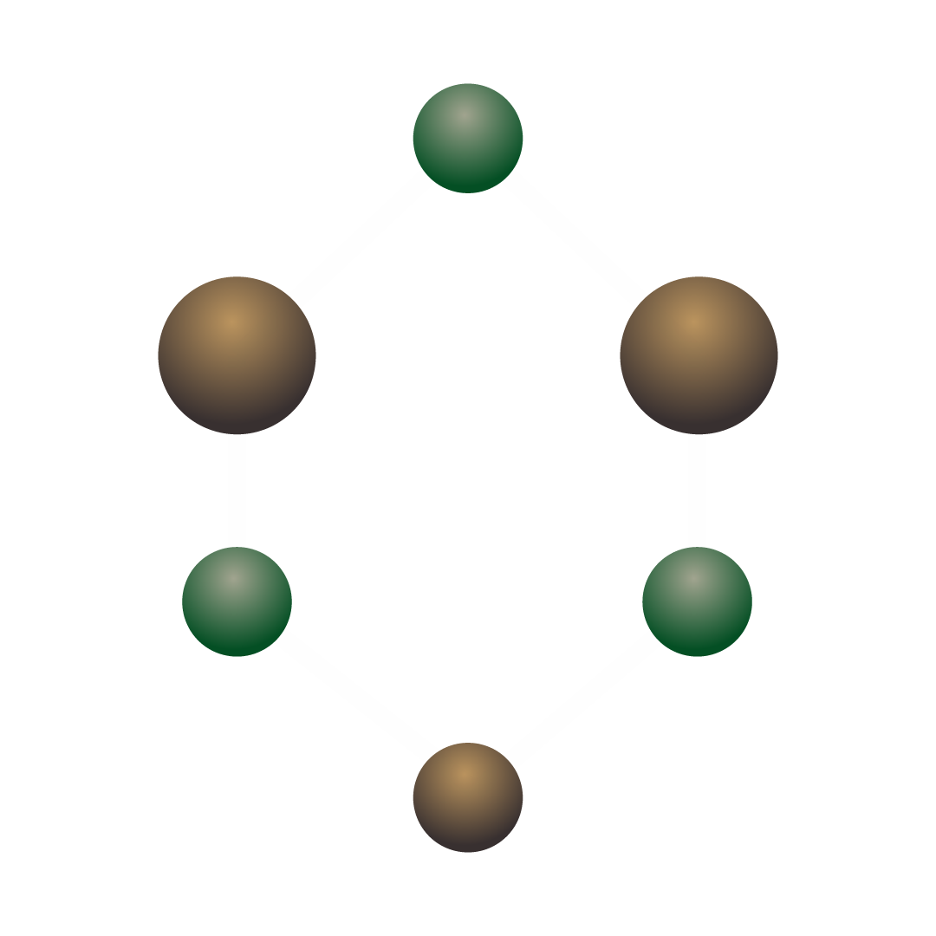
Why AI in Chemistry?
Chemistry has huge data (molecules, reactions, structures). You can organize your ideas clearly.
AI can analyze this data quickly.
Helps chemists make better decisions.
Saves time and reduces cost in research.

Slide 9
Advantages of AI in Chemistry
1) Faster research
2) More accurate predictions.
3) Reduce extra Cost
4) Reduces human error
5) Helps discover new materials and medicines

Slide 10

200,000,000
AI has predicted over 200 million protein structures, helping scientists understand chemistry faster.

Slide 11
Il
Applications of AI in Chemistry

Slide 12
Areas Where AI is Used in Chemistry
Drug discovery.
Chemical reaction prediction.
Material design.
Molecular structure analysis.
Laboratory automation.

Slide 13
lll
AI in Drug Discovery

Slide 14
AI in Drug Discovery
1) AI helps find new medicines faster
2) Predicts how a molecule will behave
3) Reduces the need for long lab experiments
4) Used to discover drugs for cancer, COVID-19, genetic diseases, etc.

Slide 15
lV
AI in Chemical Reaction & Structure Prediction

Slide 16
AI in Chemical Reaction Prediction?
AI models can predict:
What product will form
Reaction conditions
Reaction Speed
Helps chemists avoid failed experiments

Slide 17
AI for Molecular Structure
1) AI tools (like DeepMind’s AlphaFold) predict 3D structures of molecules
2) Helps understand how proteins work
3) Important for medicine and biotechnology

Slide 18
V
AI in Laboratory Automation

Slide 19
AI in Lab Automation
1) Robots controlled by AI perform lab work
2) Mixing chemicals
3) Running experiments
4) Collecting and analyzing data
5) Makes research faster and safer

Slide 20
VI
AI in Material Science

Slide 21
AI in Material Science
1) AI designs new materials like:
Better batteries
Stronger metals
Lightweight materials
2) Used in electronics, aerospace, renewable energy

Slide 22

AI’s primary Impact Areas in Chemistry
45%
30%
Drug Discovery & Optimization
Advanced Materials Design
10%
15%
Lab Automation & Efficiency
Retrosynthess & Prediction

Slide 23
VII
Conclusion

Slide 24
Summary
AI is transforming modern chemistry
Helps in drug development, reaction prediction, material design
Increases speed, accuracy, and safety
Makes scientific research more efficient

Slide 25
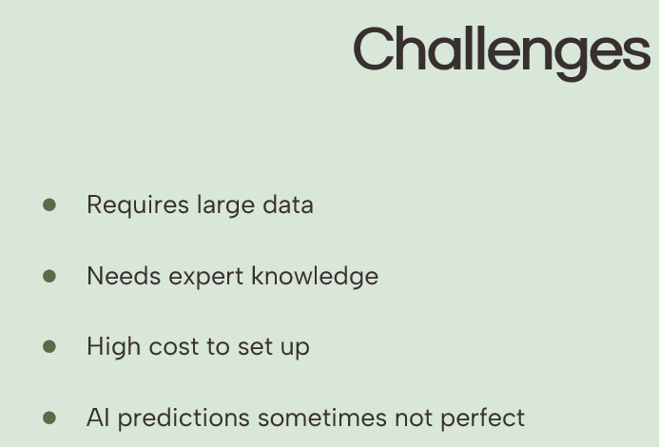

Slide 26
Final Thoughts
Chemical Analysis Automation
Drug & Material Development
Molecular Structure Prediction
AI helps automate chemical testing and data analysis, making experiments faster and more accurate.
AI speeds up the discovery of new medicines and designs advanced materials like better batteries and polymers.
AI predicts the 3D structure of molecules and proteins, helping scientists understand chemical behavior.

Slide 27


Slide 28


